Slide 1
Week 7a
COMPUTATIONAL MATHEMATICS
Interpolation – Direct Interpolation

Slide 2
Reference
Kisualaas, Jann. (2013). Numerical Methods in Engineering with Python 3. Cambridge University Press.
Johansson, Robert. (2015). Chapter 5. Equation Solving. Numerical Python: A Practical Techniques Approach for Industry, Apress.
Chapra, S. C., and Raymond P. Canale. (2010). Numerical methods for engineers, Sixth edition, McGraw Hill.
Kaw, A. (n.d.). Numerical Methods. Retrieved March 20, 2020, from https://nm.mathforcollege.com/

Slide 3
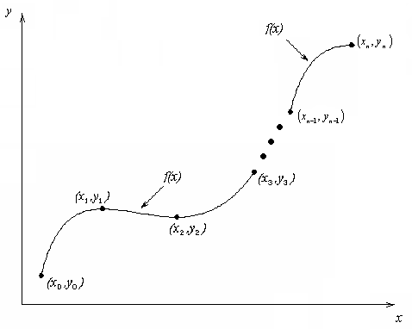
What is Interpolation ?
Given (x₀,y₀), (x₁,y₁), …… (x_{n},y_{n}), find the value of ‘y’ at a value of ‘x’ that is not given.
Figure 1 Interpolation of discrete.

Slide 4
Interpolants
Polynomials are the most common choice of interpolants because they are easy to:
Evaluate
Differentiate, and
Integrate

Slide 5

Interpolation vs Regression
Interpolation
Given 𝑛n data points, when you interpolate, you look for a function that is of some predefined form that has the values in that points exactly as specified. That means given pairs (𝑥𝑖,𝑦𝑖) you look for 𝐹 of some predefined form that satisfies 𝐹(𝑥𝑖) = 𝑦𝑖. 𝐹 is chosen to be polynomial, spline (low degree polynomials on intervals between given points).
Regression
When you do regression, you look for a function that minimizes some cost, usually sum of squares of errors. You don't require the function to have the exact values at given points, you just want a good approximation. In general, your found function 𝐹 might not satisfy 𝐹(𝑥𝑖) =𝑦𝑖 for any data point, but the cost function, i.e.
will be the smallest possible of all the functions of given form.

Slide 6
Direct Method
Given ‘n+1’ data points (x₀,y₀), (x₁,y₁),………….. (x_{n},y_{n}),
pass a polynomial of order ‘n’ through the data as given
below:
where a₀, a₁,………………. a_{n} are real constants.
Set up ‘n+1’ equations to find ‘n+1’ constants.
To find the value ‘y’ at a given value of ‘x’, simply substitute the value of ‘x’ in the above polynomial.

Slide 7
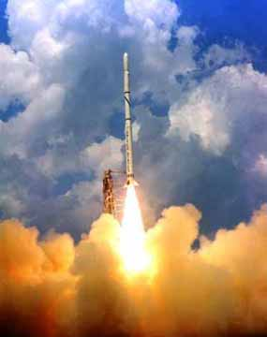
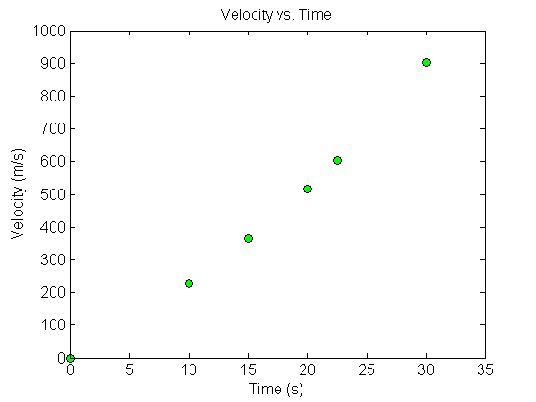
Example 1
The upward velocity of a rocket is given as a function of time in Table 1.
Find the velocity at t=16 seconds using the direct method for linear interpolation.
Table 1 Velocity as a function of time.
0 | 0
10 | 227.04
15 | 362.78
20 | 517.35
22.5 | 602.97
30 | 901.67
Figure 2 Velocity vs. time data for the rocket example

Slide 8
Linear Interpolation
Solving the above two equations gives,
Figure 3 Linear interpolation.
Hence

Slide 9
Example 2
The upward velocity of a rocket is given as a function of time in Table 2.
Find the velocity at t=16 seconds using the direct method for quadratic interpolation.
Table 2 Velocity as a function of time.
0 | 0
10 | 227.04
15 | 362.78
20 | 517.35
22.5 | 602.97
30 | 901.67
Figure 5 Velocity vs. time data for the rocket example

Slide 10
Quadratic Interpolation
Figure 6 Quadratic interpolation.
Solving the above three equations gives

Slide 11
Quadratic Interpolation (cont.)
The absolute relative approximate error obtained between the results from the first and second order polynomial is

Slide 12
Example 3
The upward velocity of a rocket is given as a function of time in Table 3.
Find the velocity at t=16 seconds using the direct method for cubic interpolation.
Table 3 Velocity as a function of time.
0 | 0
10 | 227.04
15 | 362.78
20 | 517.35
22.5 | 602.97
30 | 901.67
Figure 6 Velocity vs. time data for the rocket example

Slide 13
Cubic Interpolation
Figure 7 Cubic interpolation.

Slide 14
Cubic Interpolation (contd)
The absolute percentage relative approximate error between second and third order polynomial is

Slide 15
Comparison Table
Table 4 Comparison of different orders of the polynomial.
t(s) | v (m/s)
0 | 0
10 | 227.04
15 | 362.78
20 | 517.35
22.5 | 602.97
30 | 901.67

Slide 16
Distance from Velocity Profile
Find the distance covered by the rocket from t=11s to t=16s ?

Slide 17
Acceleration from Velocity Profile
Find the acceleration of the rocket at t=16s given that

